Slide 1
Pay N Split
Mentor: Mr. Santosh Nagargoje
Group members:
Sairam B 39004
Mayur Chinche 39018
Rajratnam Shetty 39071
Viren Varma 39079

Slide 2
ABSTRACT
Pay N Split is designed to be a versatile bill-splitting app to fit most situations where you need to split costs between multiple people.
You can create groups with various friends and divide up what each person owes. All your shared expenses are organized in one place and everyone in the group can see the amount they owe.
The app tracks borrowing and lending over time. And, until the balance is settled up, each person’s outstanding balance may go up and down.
This application provides an easy user interface which helps people to manage their expenses and contribution for group activities. This app is easy to learn and efficient to use.

Slide 3
INTRODUCTION
In the past, splitting the cost of bills and expenses was a clumsy process. You had to calculate who owed what, then go through the tedious task of collecting money from each person. And since fewer people are carrying cash less often these days, settling up gets even more difficult. That is, until Pay N Split app.
Pay N Split app lets you divide up the cost of things like group dinners and group trips so that everyone can pay their fair share. With Pay N Split, you’ll be able to keep the peace between friends by cutting down on squabbles about who owes what to whom.
One of the advantages of the app is that it gives you a multitude of payment options like Paytm, UPI and Cash to pay and clear your bills. The user-friendly user interface is also easy to use and adapt.

Slide 4
The app allows you to maintain personal and group transactions separately. This leads to efficient management of one’s expenses. The bill is calculated and every member gets information about how much is his contribution and how much he has to pay or receive.
Pay N Split can be used in a variety of occasions in our life. It can be specifically used between roommates to manage their daily collective expenses for the room.

Slide 5
OBJECTIVES
Provide a software application for bill splitting.
To bring in an easy user interface and interactive application which provides feasible options to users.
To manage the expenses of members in a group.
To easily collect money from a group.
Provide features to easily split expenses among friends.
To minimize time for processing of various tasks, thereby reducing the time consumption.
To reduce the manual work for members as the calculations are accomplished automatically with the help of application software.
This app aims to make shared living simple.

Slide 6
METHODOLOGY
We have developed an application for people living in a group to split their bills amongst themselves. The bills can be splitted by the end of the month to ensure that every member of the group contributes his part and receive what he has payed extra. For a new user to use the app, he has to create an account. This can be done by clicking on the Sign-up button. He has to enter his credentials to login to an account which is already existing.
When the user is logged in, he has the option to either create a group or join a group. If the user chooses to create a group, he gets a unique group-id through which he can add members. Users can join a group by using the group-id created by the admin.

Slide 7
The homepage consists of all the groups in which the user is present. The groups can be navigated by using a list. Whenever the user opens a particular group, he is directed to an activity page. The activity page consists of multiple tabs like:
1. Pay
2. View Transactions
3. Add members

Slide 8
ARCHITECTURE
USER
USER INTERFACE
Application
SDK LIBRARY
PAYMENT API
DATABASE
SERVICE

Slide 9
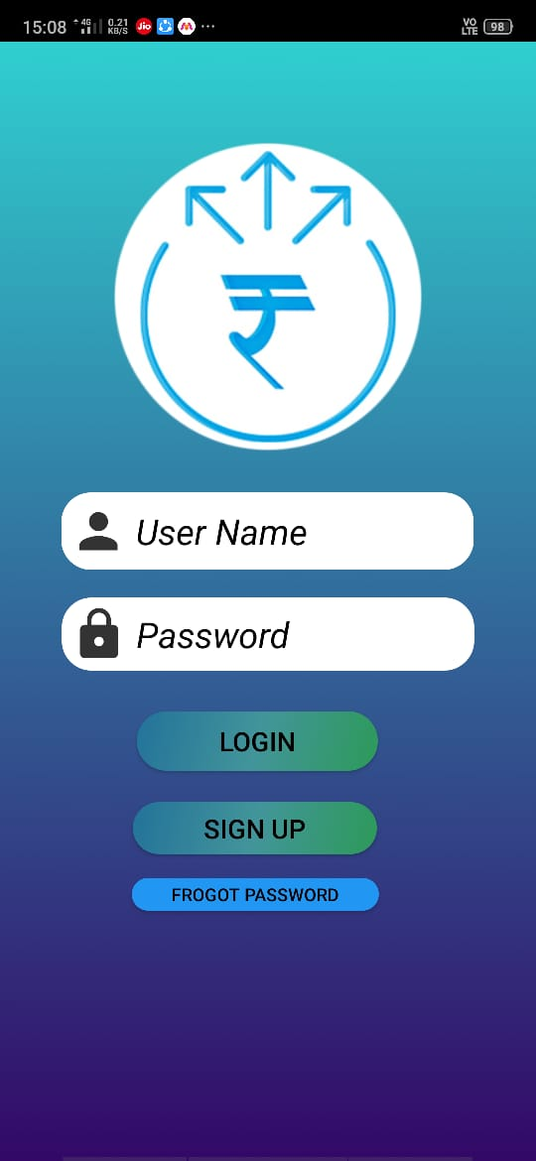
IMPLEMENTATION DETAILS
Login Screen:
On this screen, we have provided two text boxes, one for Email ID and one for password to sign in.
If you do not have an existing account, you have to click on the Sign-up button which will redirect you to the sign-up page.

Slide 10
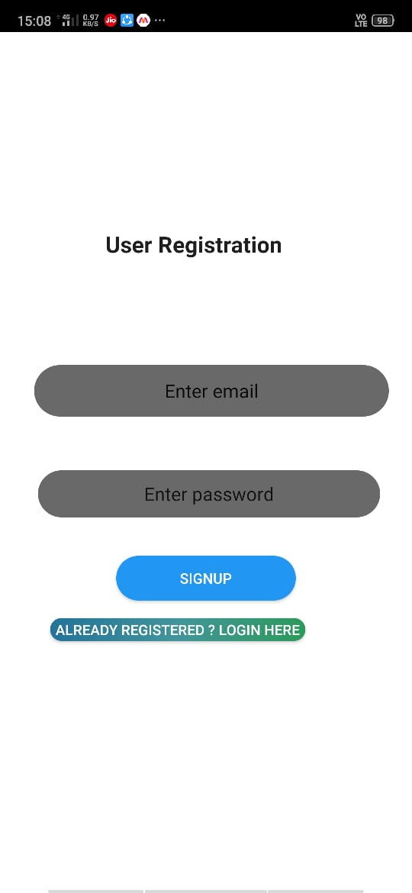
Sign Up/Create Account Screen
Here, the user has a provision to add their Email ID, Password (which must be more than 6 characters long).
Once the user has filled all those details, the user can click the Sign-Up button to create their user profile in the database

Slide 11
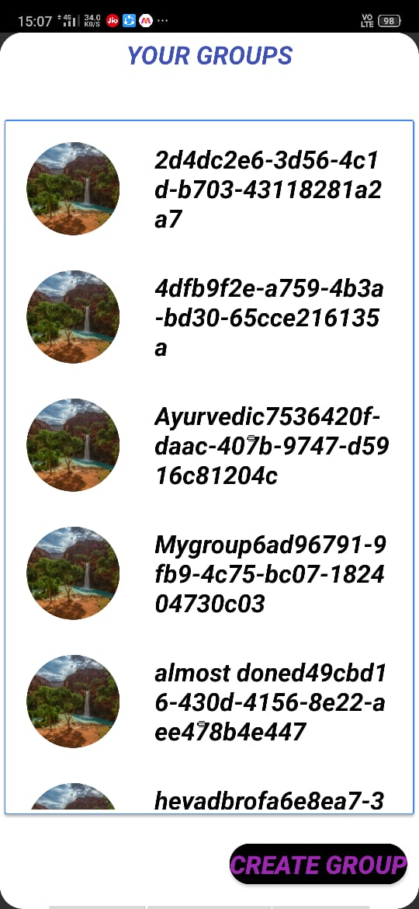
Home screen
Here, user can see options for viewing groups. The groups are arranged in a list format which makes it easy to view all the groups at a single place.
It also has a Create Group button through which the user can create a new group and invite members.

Slide 12
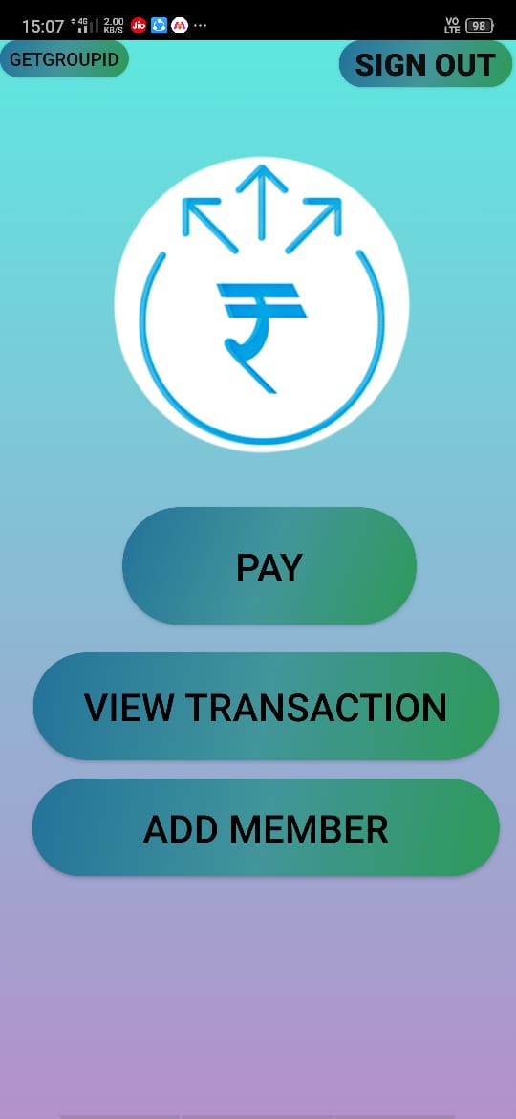
Activity Screen
After clicking on a particular group, the user is redirected to the activity page. Here, he can perform activities like paying bills, viewing transactions and adding members.
The activities can be performed by using the buttons: Pay, View Transactions and Add Members.

Slide 13
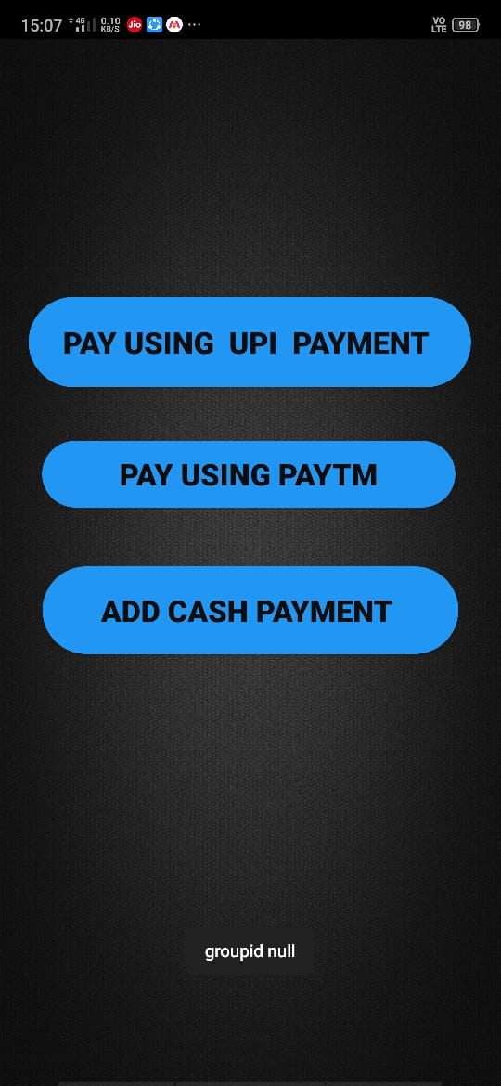
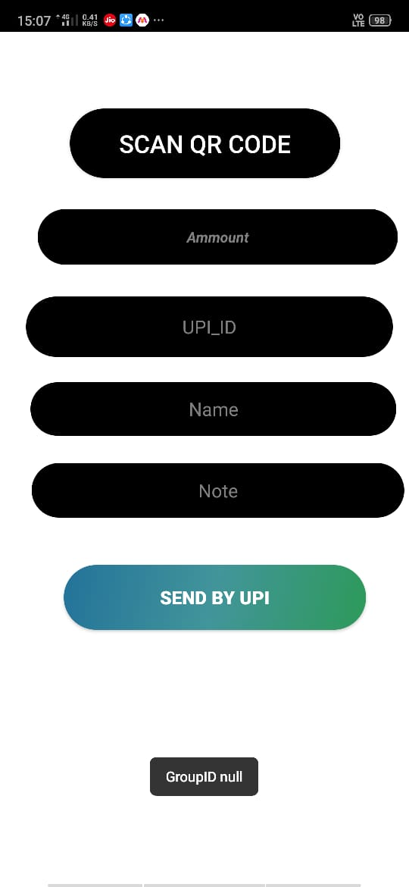
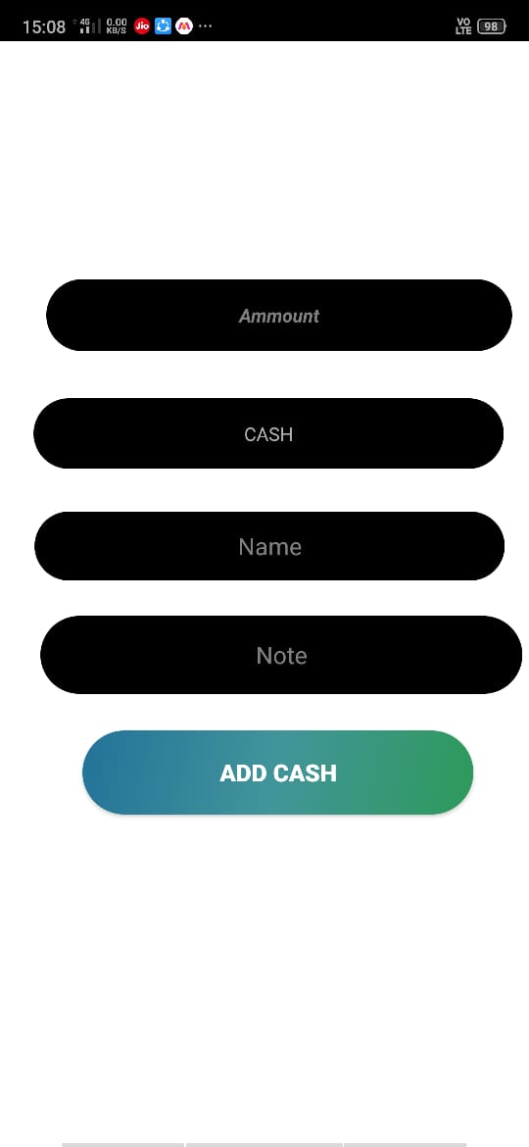
Payment Activity
The payment activity consists of various payment options like UPI, Paytm and Cash Payment. The user can choose payment option of his choice to complete the transactions.
This page consists of buttons which redirect you to the respective payment options API.

Slide 14
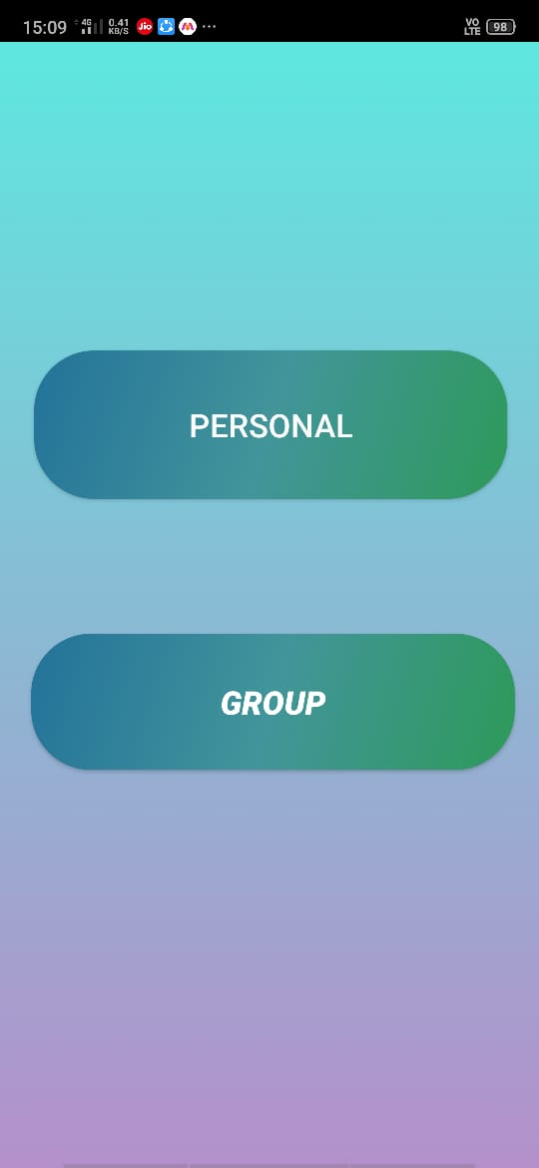
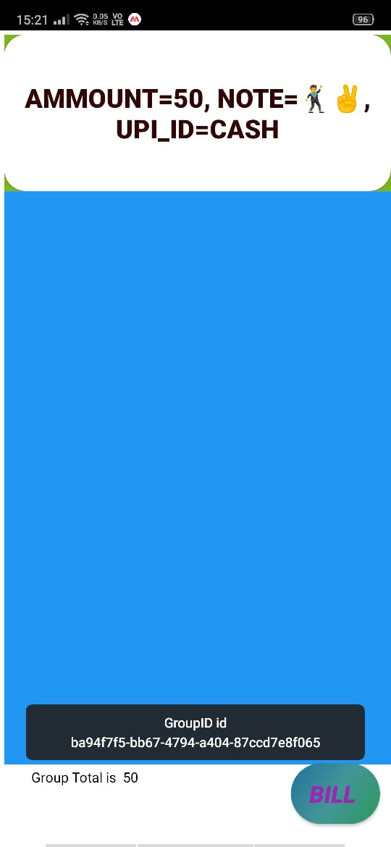
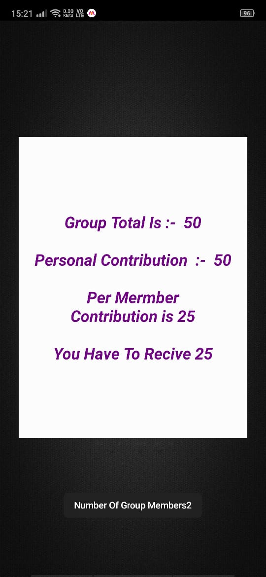
View Transactions Activity
In this tab two buttons are provided one for personal transactions and another for group transactions.
In personal transactions, user will be able to see his transactions only. In group transactions, all the transactions of multiple users will be shown.

Slide 15
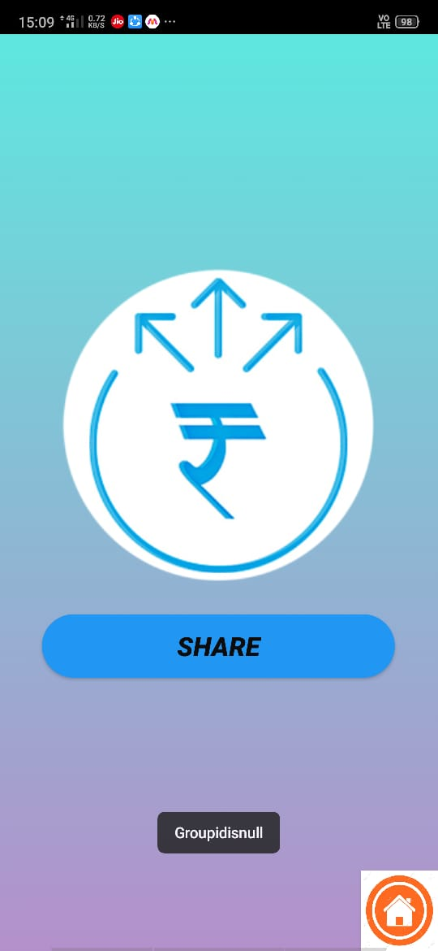
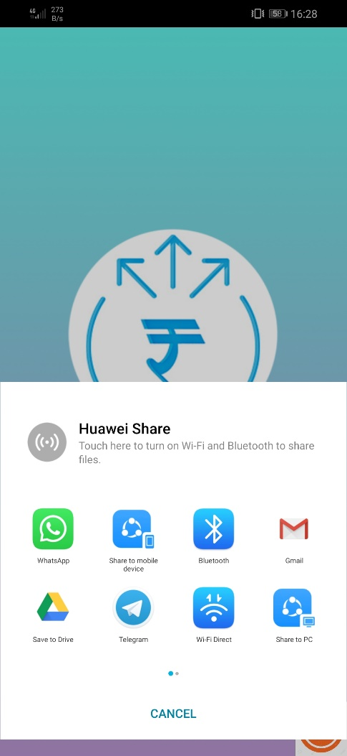
Add Members Activity
In this activity, we can add new members to our existing group. The method by which we can add a new member is by generating a unique group-id.
The unique group-id is then shared to the person we want to add via WhatsApp, Text Messaging and all other media.

Slide 16
FUTURE SCOPE
We can edit our user profile.
Improve the general management and UI to create a more user-friendly application.
We can add more payment options.
Can include a wallet for better management of expenses.
When the transaction is made, we could record the time and date of it to know exactly when we did the transactions.

Slide 17
CONCLUSION
Pay N Split is an app that takes the trouble out of sharing expenses with friends, roommates and everyone else. It does all the math for you because it keeps a running total over time, so you can pay each other back in one big payment instead of a bunch of small ones.
It is all organized in one place so everyone can see who they owe money to. No matter if you are sharing a lunch with a friend, watching a movie in a group, paying rent with your roommate or going on a ski trip, there is no more need to worry about money because Pay N Split will do all the work for you fair and square.

